Slide 1
The Difference Makers
Chairman’s Address
National Grain and Feed Association
120th Annual Convention
March 15, 2016
San Diego, Calif.
Gary Beachner, NGFA Chairman;
President and CEO Beachner Grain Co., Parsons, Kan.

Slide 2
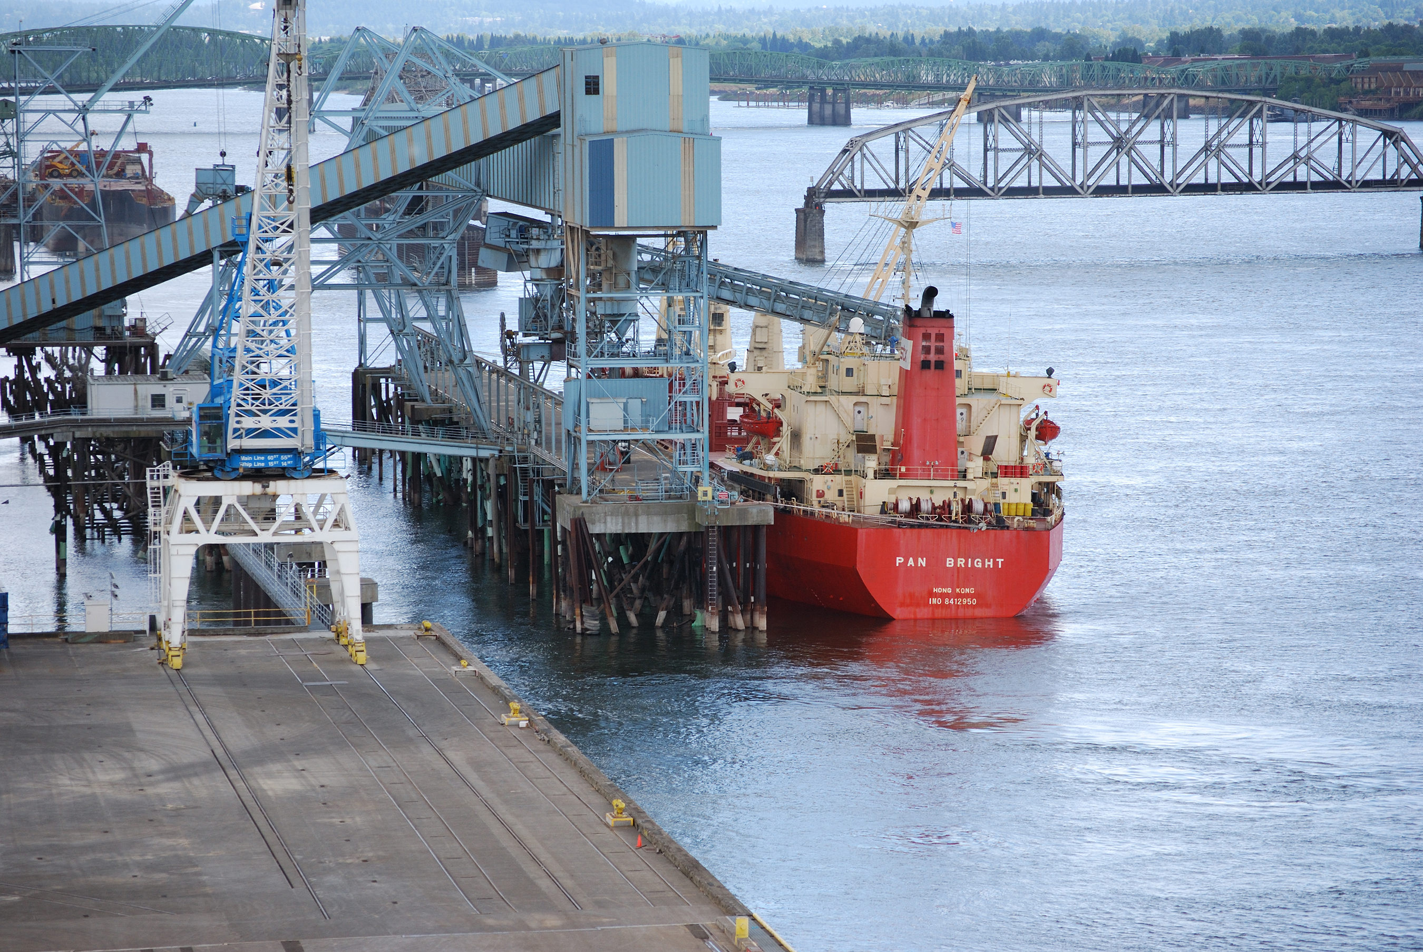
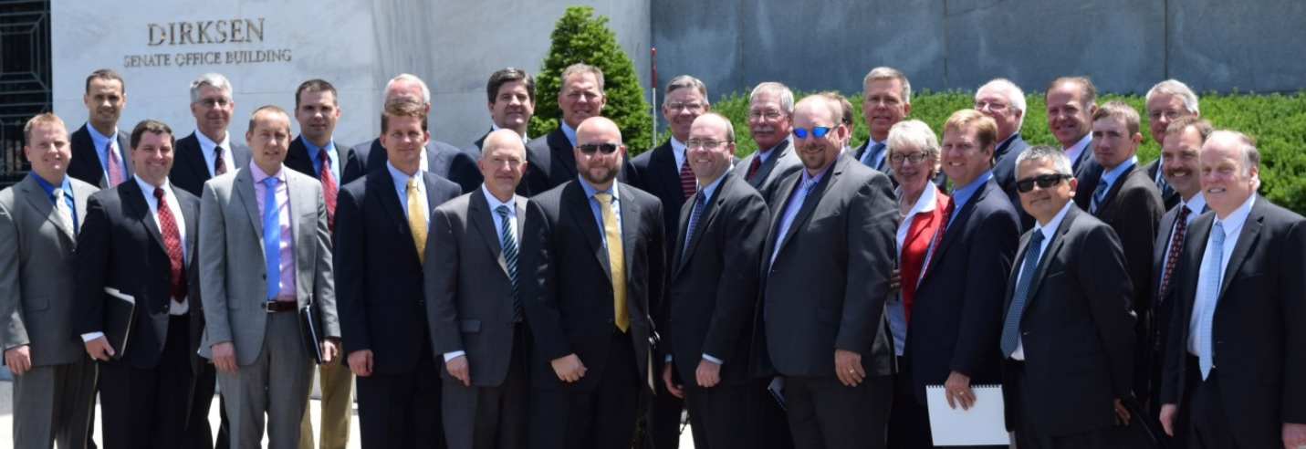
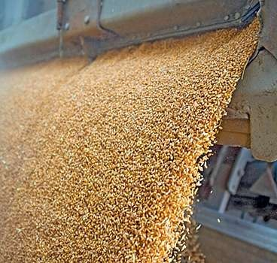
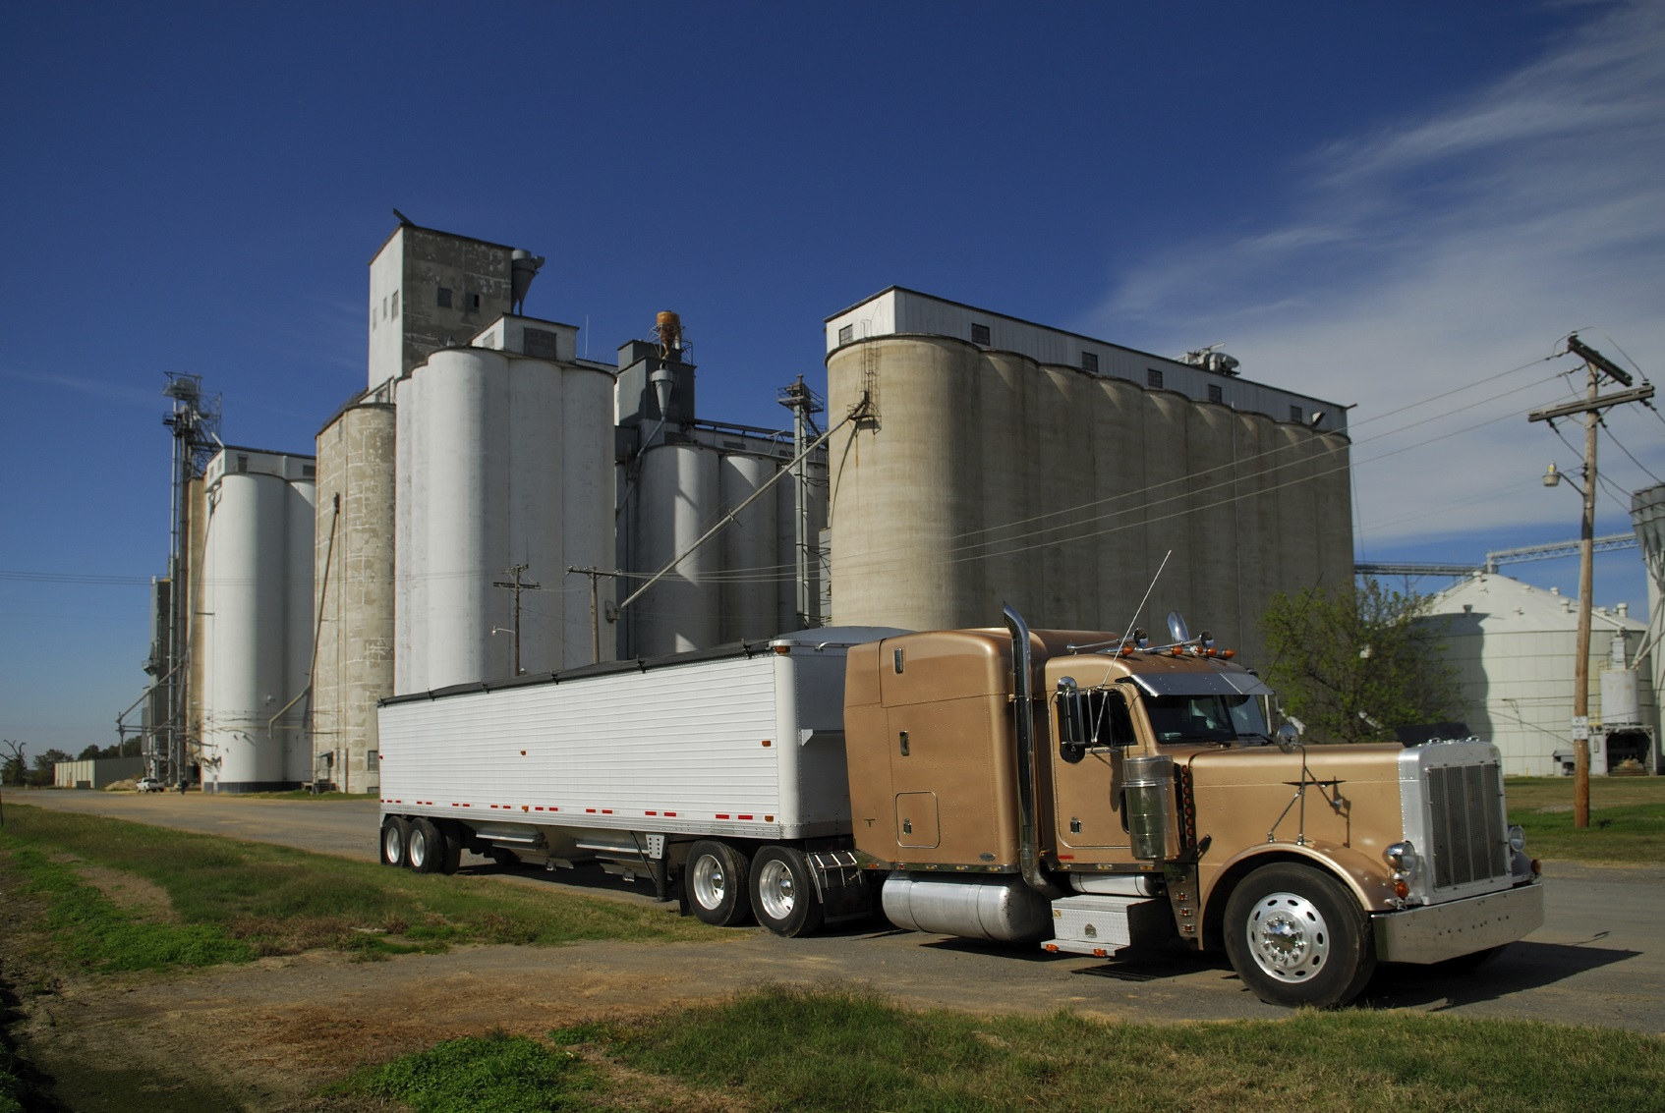
Our Industry

Slide 3
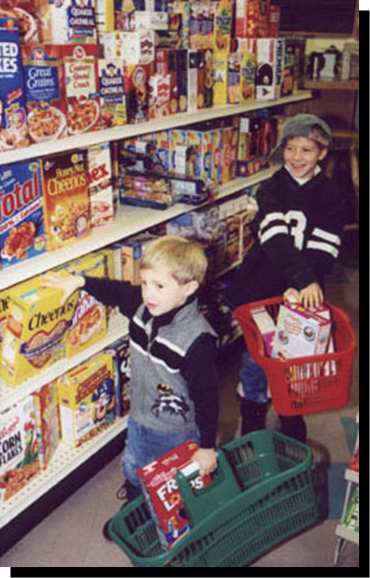
Noble Purpose
Safe, sustainable and affordable food supply

Slide 4
Industry Principles
Integrity
Trust
Ethical Business Conduct

Slide 5
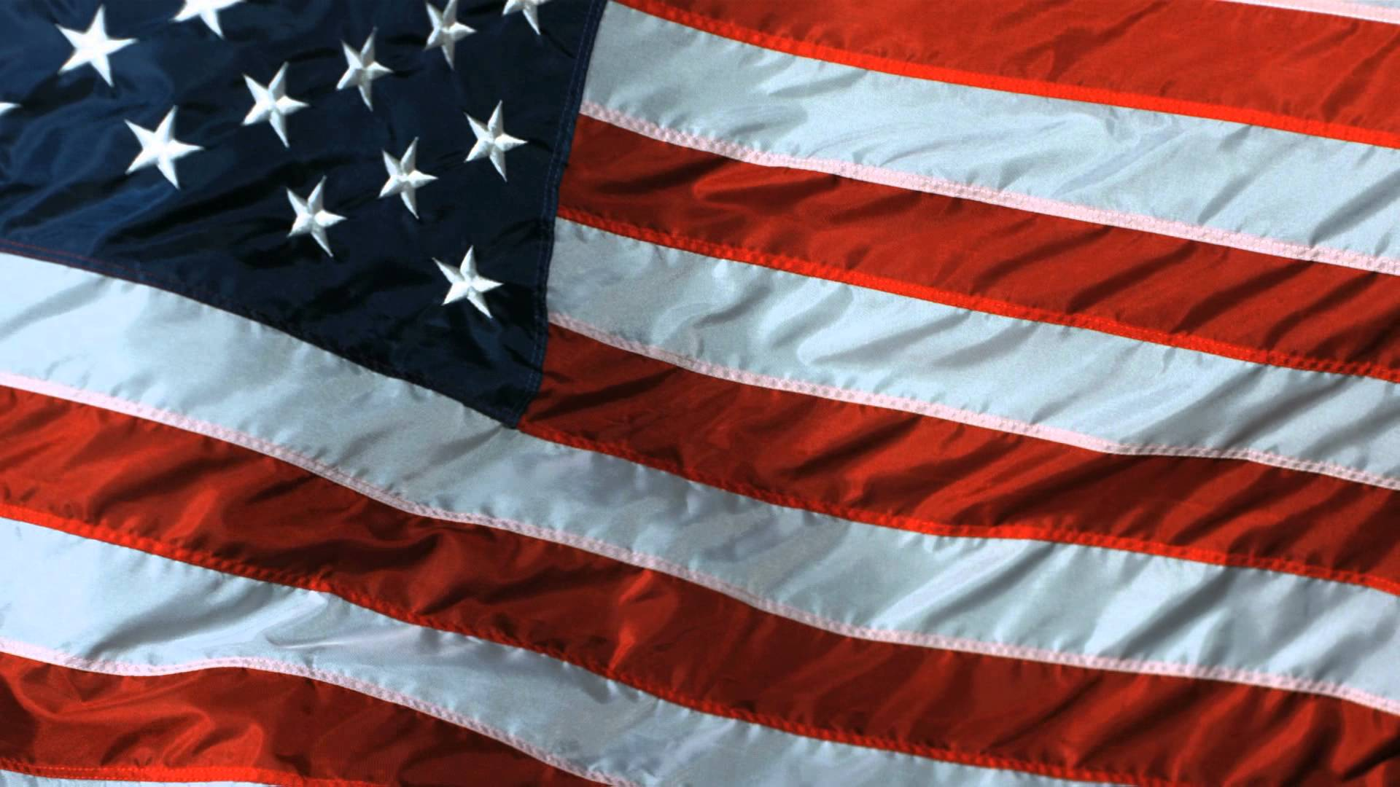
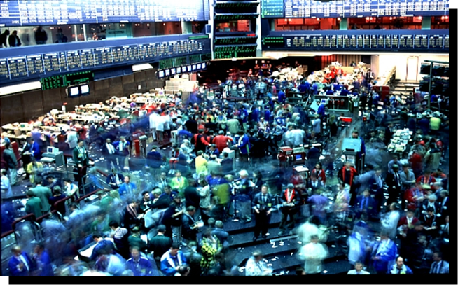
Bedrock Principles
Free markets
Free-enterprise
Competition

Slide 6
Who’s Out of Step?

Slide 7
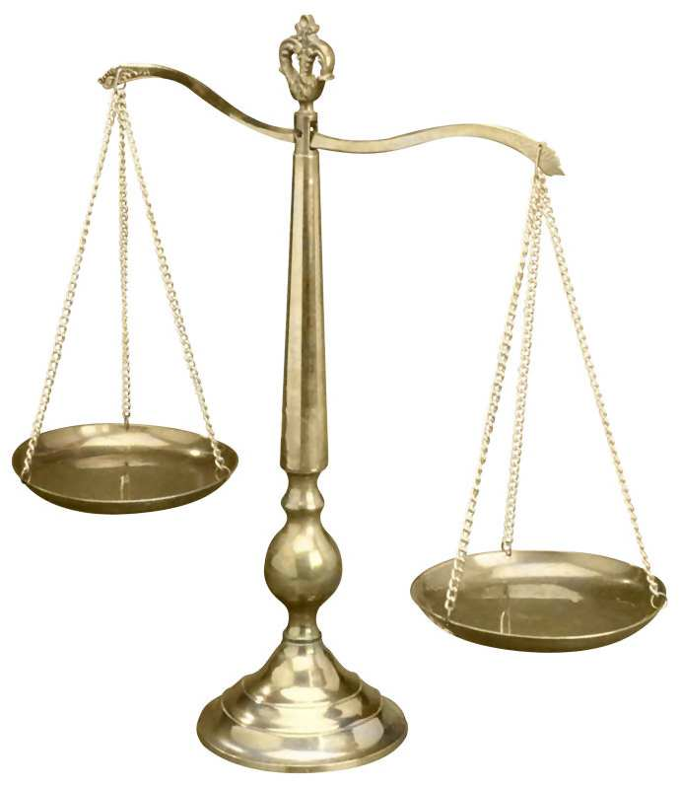
NGFA Trade Rules and Arbitration
One of the NGFA’s most-valued, most-used and most-respected membership services.

Slide 8
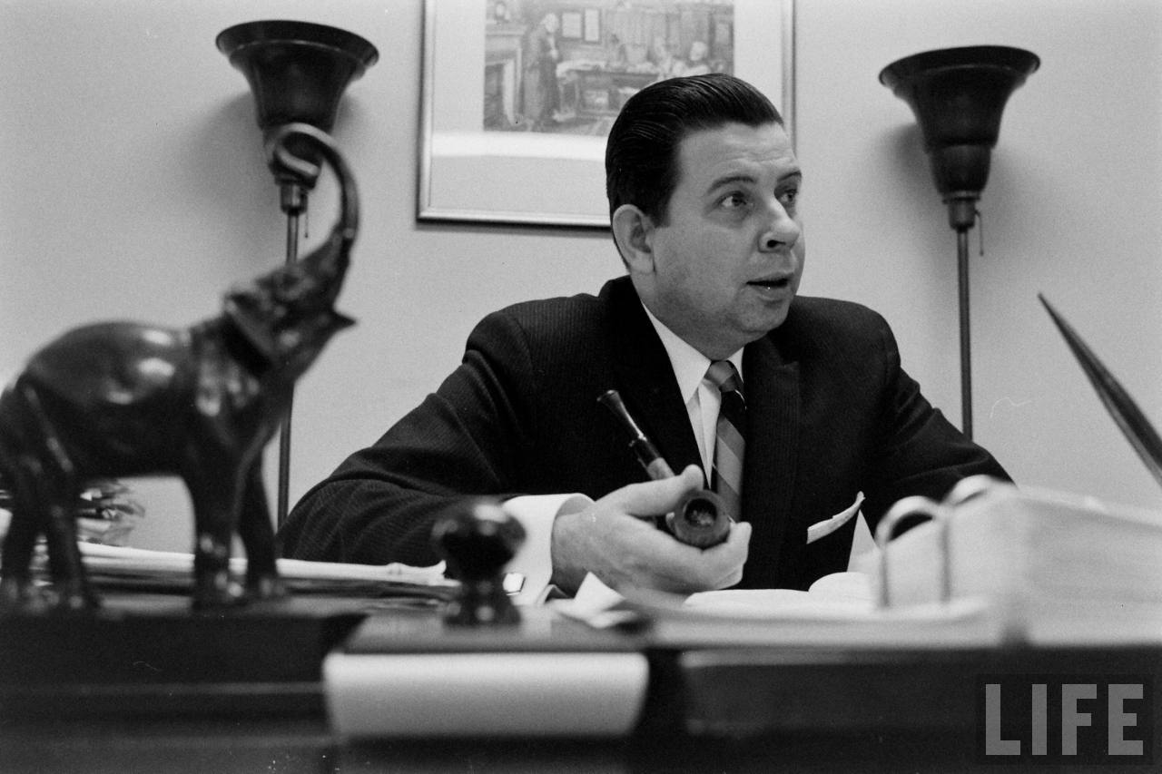
NGFA Trade Rules and Arbitration
Earl Kintner: NGFA’s Trade Rules and Arbitration System = a “special jewel”

Slide 9
NGFA Trade Rules and Arbitration
There are five sections to the full set of Trade Rules established and maintained by the NGFA:
Grain Trade Rules: Adopted in 1902, these rules govern all transactions of a financial, mercantile or commercial nature involving grain. Grain, as defined by the U.S. Grain Standards Act, means corn, wheat, rye, oats, barley, flaxseed, grain sorghum, soybeans, mixed grain and any other food grains, feed grains and oilseeds for which standards are established under 7 U.S.C. Section 76.
Feed Trade Rules: Adopted in 1921, these rules govern transactions of all feedstuffs (including mill products or byproducts). Users of these rules should note that references are made to American Association of Feed Control Officials (AAFCO) definitions.
Barge Trade Rules: Adopted in 1964, these rules supplement the Grain Trade Rules and Feed Trade Rules whenever such shipments are designated by contract to be transported by barge.
Barge Freight Trading Rules (affreightment): Adopted in 1981, these rules govern all disputes of a financial, mercantile or commercial character involving transactions in the purchase and/or sale of barge transportation.
Secondary Rail Freight Trading Rules: Adopted in 2007, these rules govern all disputes of a financial, mercantile or commercial character involving transactions between non-railroad parties in the purchase and/or sale of secondary rail freight transportation.

Slide 10
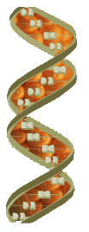
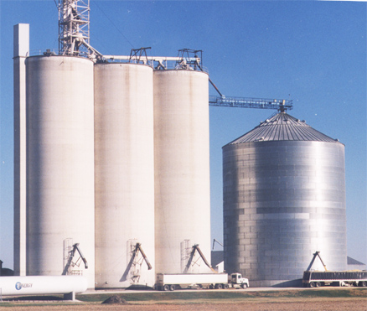
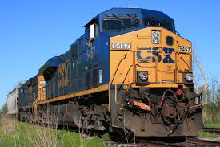
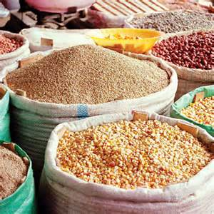
Arbitration: Can It Be Expanded to Other Commercial Relationships?

Slide 11
Marketing Biotechnology…
Biotech-enhanced traits should be commercialized only after achieving broad, deep consumer acceptance, as well as authorizations from U.S. export markets, to enable the industry to meet customer preferences and maintain access to global markets.
The NGFA advocates prudent policies to guard against the presence of unauthorized or restricted-use biotech-enhanced traits in the general commodity stream.

Slide 12
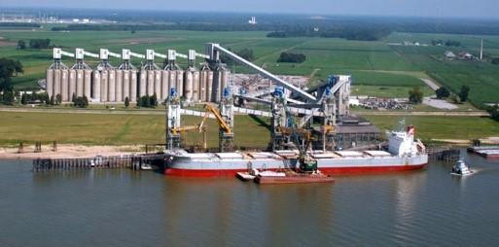
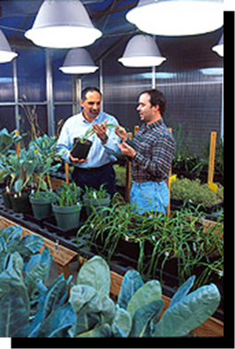
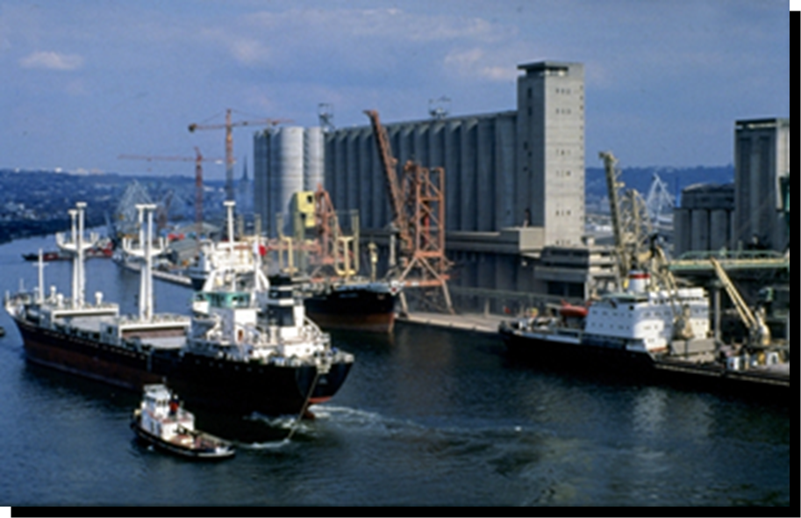
…In a Global Marketplace

Slide 13
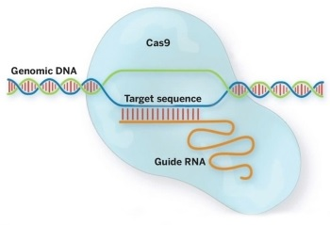
New GE Breeding Technology

Slide 14
Addressing New GE Breeding Technologies
Non-transgenic gene editing, cisgenics, etc.
Lower cost technology; likely many more entrants (e.g., small innovators, colleges)
Chance to get international regulatory process right
But if not, trade disruptions multiply
USDA-APHIS Considering Change in Process for Regulating Biotech Traits
Support for Federal Preemption Biotech Labeling Bill

Slide 15
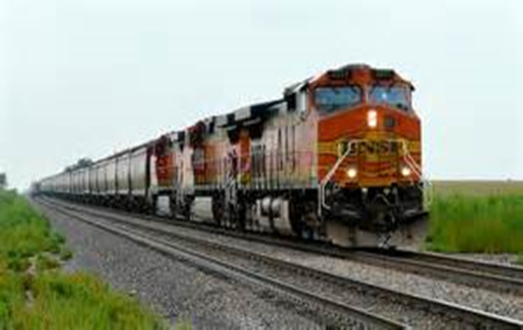
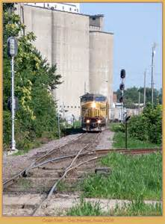
Rail Arbitration
Can our Rail Arbitration Rules be expanded to apply to additional areas of
shipper-carrier disputes, including
rates and accessorial charges?

Slide 16
STB Encouraging NGFA, Carriers to Explore Arbitration Solution

Slide 17
Regulatory Overreach

Slide 18
CFTC and the Dodd-Frank Act
Dodd–Frank Wall Street Reform and Consumer Protection Act signed into law by President Obama on July 21, 2010.
Fundamentally restructures U.S. financial regulation, requiring host of rulemaking actions.

Slide 19
Preserving Ability to Efficiently Hedge
Hedging strategies potentially at risk by CFTC’s original definition of “bona fide” hedge:
Pre-hedging of farmer grain purchases outside of exchange trading hours, such as weekends;
Pre-setting of futures carrying charges to manage spread risk (such as before harvest);
Anticipatory hedges prior to export tenders.

Slide 20
FDA and Food Safety Modernization Act
Signed into law on Jan. 4, 2011
Greatly expands FDA’s authority to regulate U.S. food supply
Mandates that FDA create a new risk-based, prevention-based regulatory safety system to minimize hazards in food/feed products

Slide 21
FSMA – How Significant?
2011
1938 – Food, Drug, and Cosmetic Act
1906 – Pure Food and Drug Act
FSMA Implementation: NGFA seeking common-sense, science-based outcomes

Slide 22
Grain Elevator Exemption
Human Food and Animal Food CGMP and Preventive Controls
Facilities “solely engaged” in storing grain and oilseeds exempt from requirements to implement CGMPs, conduct hazard analysis, implement preventive controls (and associated recordkeeping), develop written food safety plan, or supply chain verification
Different treatment for elevators handling “fruits” [i.e., lentils, kidney beans, pinto beans, lima beans, coffee beans, cocoa beans, peanuts, tree nuts and seeds for direct consumption (e.g., sunflower seeds)]
Elevators solely engaged in storing, handling such “fruits” exempt from CGMP requirements, but not exempt from the preventive controls and supply chain program requirements

Slide 23
Food Safety Preventive Control Alliance
FSPCA Training
FDA-recognized hazard analysis and preventive controls training for food/feed industry and regulatory personnel --
Developed by subject-matter experts from government, industry, academia – Animal Food Subgroup chaired by NGFA’s Dave Fairfield
Individuals completing training will be “preventive controls qualified individuals”
Curriculum to be available in June 2016
Likely will be a 20-hour course

Slide 24
NGFA Feed Education
NGFA 1-Day Awareness, Outreach Education Events
In cooperation with State Feed Regulatory Agencies and NGFA State/Regional Affiliate Associations
California, Indiana, Iowa, Kansas, Minnesota, Nebraska, Oklahoma, Wisconsin

Slide 25
Trans-Pacific Partnership

Slide 26
No Easy Task!!!

Slide 27
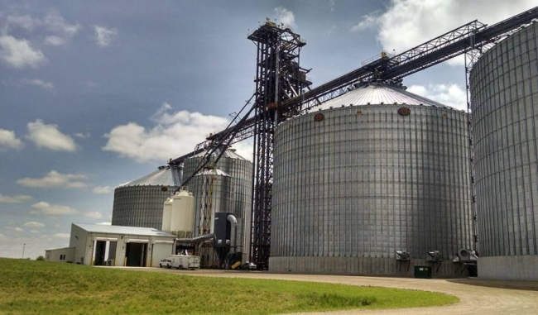
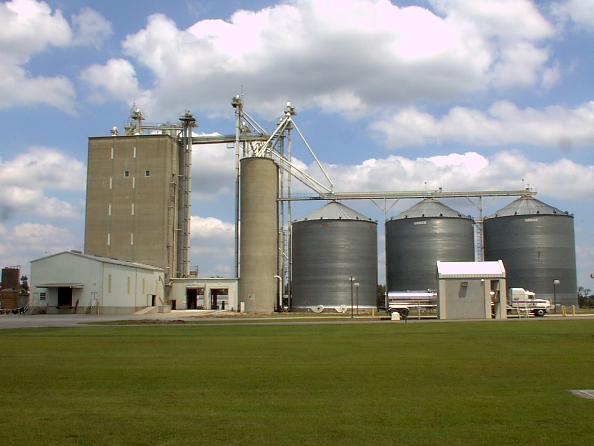
Proactive Education, Training Outreach

Slide 28
Grain Handling Safety Seminars
Rocky Mountain Agribusiness Association (RMAA) – Jan. 11 in Denver
Nebraska Grain and Feed Association – Jan. 13 in Grand Island
Montana Grain Elevator Association – Jan. 26 in Great Falls
Oklahoma Grain and Feed Association/Texas Grain and Feed Association–Feb. 24 in OKC
Ohio Agribusiness Association and Agribusiness Council of Indiana – March 8 in Columbus
Regional Safety Seminars

Slide 29
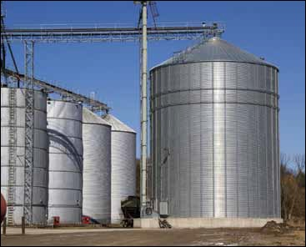
Recruiting New Staff

Slide 30
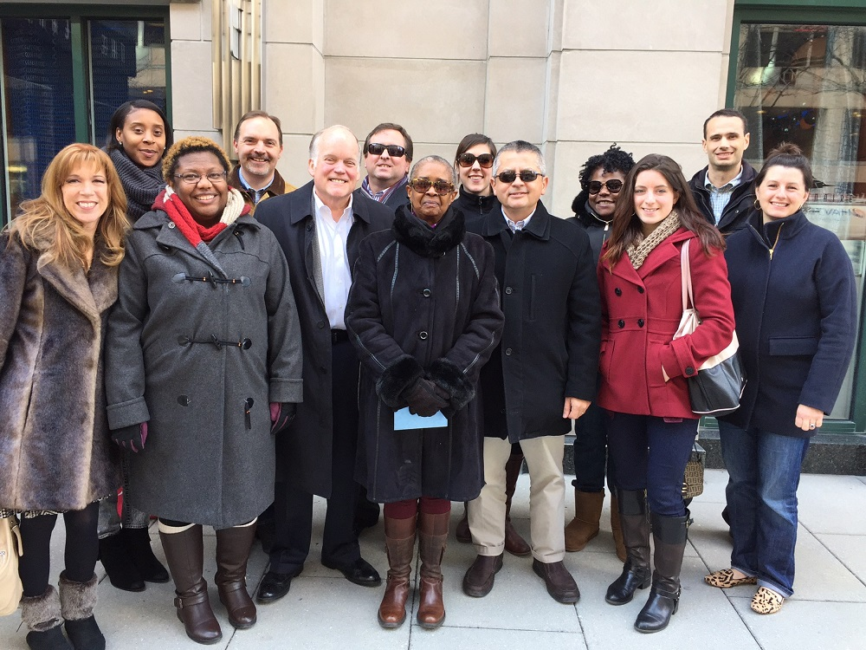
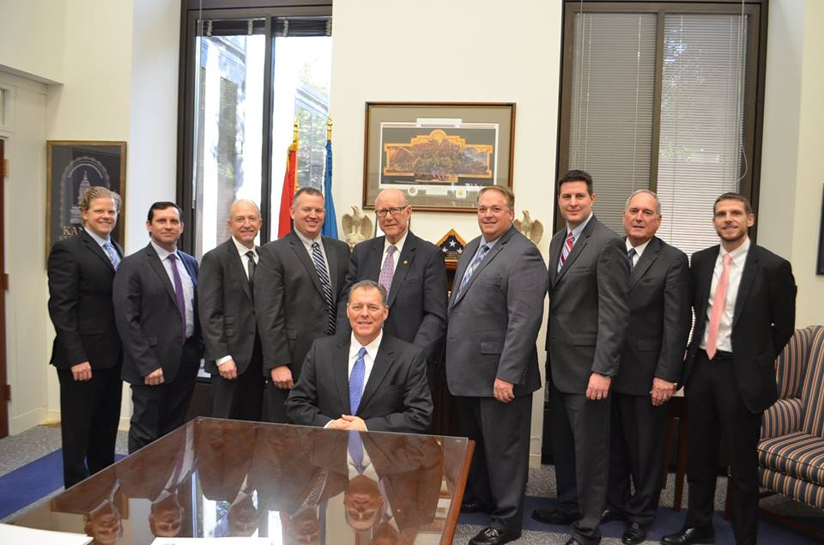
Inherent Strength – Broad Grass Roots

Slide 31
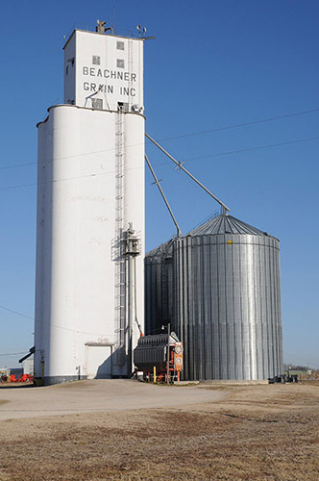
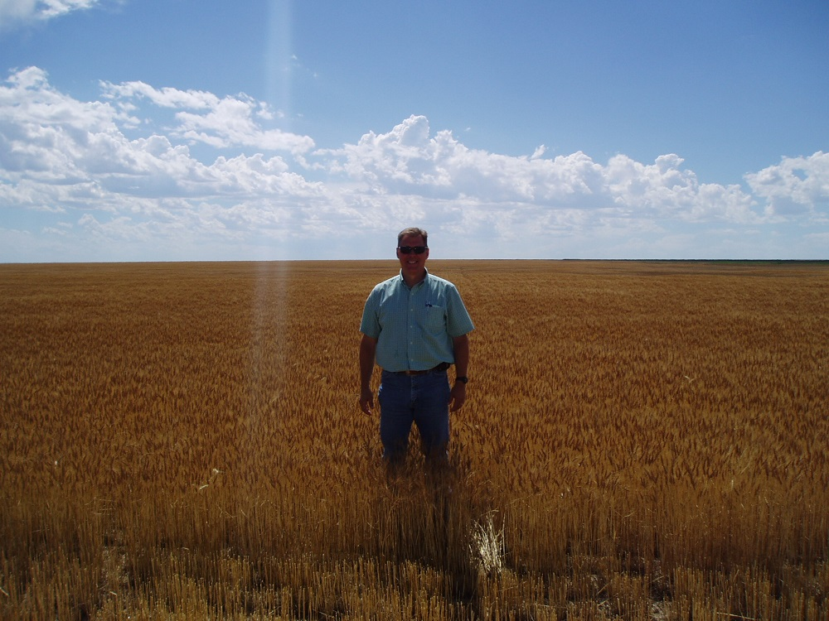
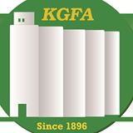
Inclusiveness of NGFA

Slide 32
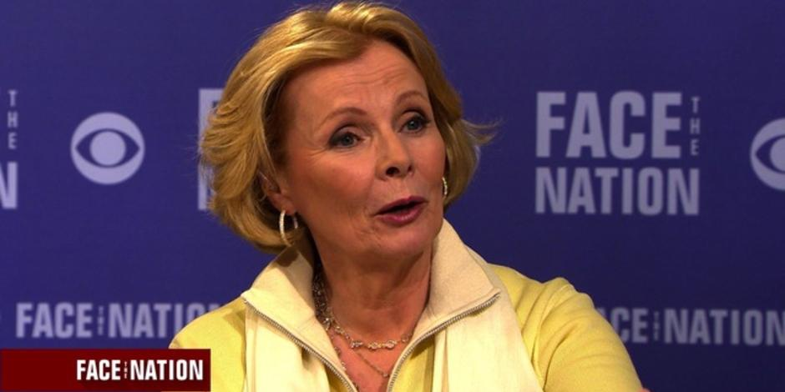
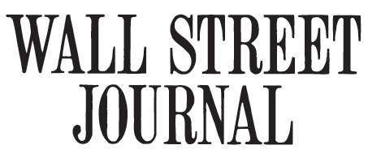
Reflections

Slide 33
Integrity of Utmost Importance!

Slide 34
Institutions Under Attack
Make a difference
by pushing back
strongly
when the principles we cherish
are attacked and denigrated.

Slide 35
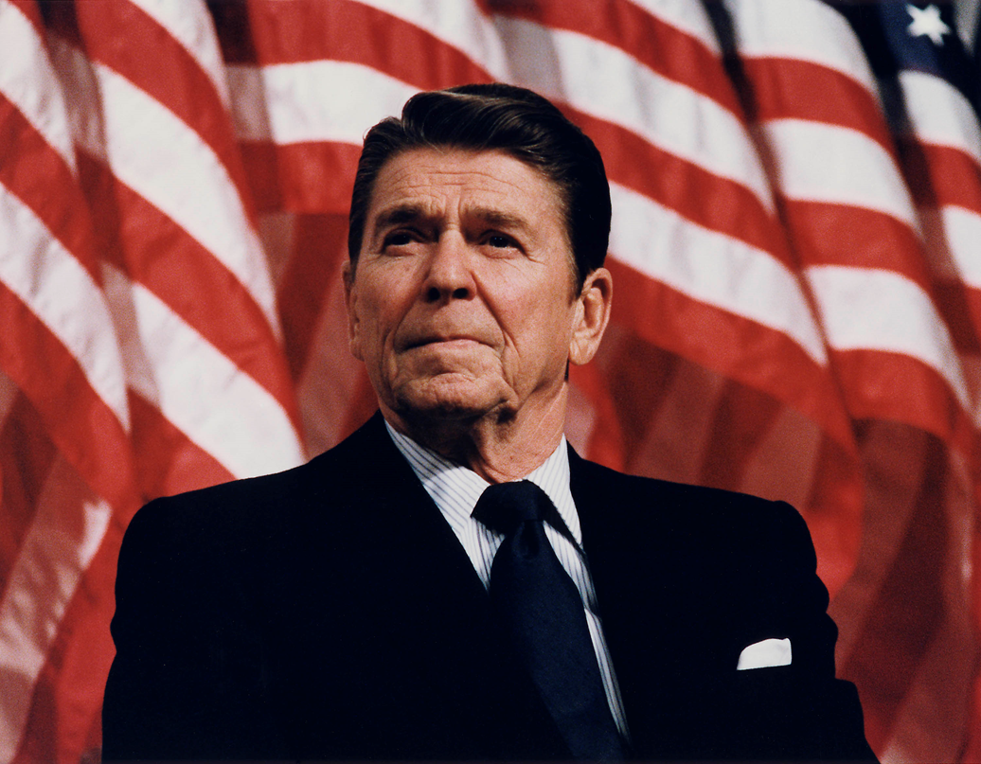
President Reagan
“There are no such things as limits to growth, because there are no limits to the human capacity for
intelligence,
imagination
and wonder.”

Slide 36
Thank You
NGFA
Difference Makers

