Slide 1
Top Regulatory Issues Facing the Grain, Feed and Processing Industry in 2016
Jess McCluer
National Grain and Feed Association
February 23, 2016
Oklahoma City, Okla.

Slide 2
Overview of Presentation
Is OSHA Still Focusing on the Grain Industry for Enforcement?
What Current Regulatory Issues Directly Impact the Grain Industry?
What Does the End of President Obama’s Second Term Mean for OSHA and Industry?

Slide 3
Notes:
In 2014, there were 36 cases where the exemption status5 of the facility with respect to OSHA regulations was known. Of those, 31 (82%) occurred on farms or other locations currently exempt from the OSHA Grain Handling Facilities Standards (29 CFR 1910.272), with the balance of 5 (13%) taking place at non-exempt commercial grain facilities. This is in strong contrast to 2013 and 2012 when 70% and 35% of all cases occurred on exempt farms. It is important to note that there were only 2 unknown cases this year and it is believed that the majority of the unknown cases, based on historical data, have OSHA exempt status.

Slide 4
Regional and Local Emphasis Programs FY 16
Local Emphasis Programs
Region V (IL, IN, WI, MI, OH) 10/01/2014
Region VII (IA, KS, MO, NE) 10/01/2014
Region VIII (CO, MT, ND, SD, UT, WY) 10/01/2014
Region X (AK, ID, OR, WA) 12/04/13
Region VI (AR, LA, NM, OK, TX) removed grain elevators from LEP
Combustible Dust NEP

Slide 5
Proactive Targeting Philosophy
OSHA Inspection Statistics (Federal and State) | FY10 | FY11 | FY12 | FY13 | FY14 | FY15
Total Inspection | 296 | 380 | 438 | 356 | 312 | 237
Percent Programmed Inspections | 46% | 60% | 63% | 61% | 58% | 48%
Total Violations Issued | 1,289 | 1,552 | 1,160 | 958 | 1,088 | 615
Notes:
Most frequently cited OSHA standards:
1910.272 – Grain Handling Standard
1910.219 – Mechanical power-transmission apparatus
1910.23 – Guarding floor and wall openings and holes
1910.146 – Permit required confined space
1910.305 – Wiring methods, components and equipment for use
Most frequently cited standards in 1910.272 include:
1910.272 (j)(1) – failure to implement a written housekeeping program
1910.272(g) (1)(i) – failure to issue a permit prior to entering a bin
1910.272(g)(1)(ii) – failure to deenergize and disconnect all equipment in a grain storage structure before employees enter.
1910.272 (j)(2)(ii) – failure to immediately remove fugitive dust accumulations, or provide equivalent protection
1910.272(m)(3) – failure to maintain a certification record of performed preventative maintenance inspections

Slide 6
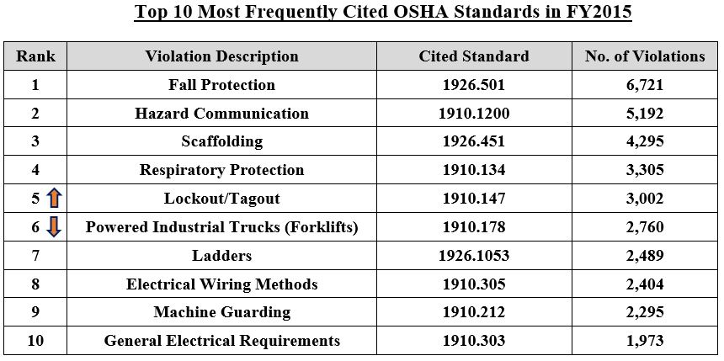

Slide 7
Most Frequently Cited OSHA Standards in Grain Handling Industry
Most frequently cited standards in 1910.272 include:
1910.272 J01 – failure to implement a written housekeeping program for fugitive dust.
1910.272 J02II – failure to immediately remove fugitive dust accumulations, or provide equivalent protection.
1910.272 G01 III – failure to test the atmosphere within a bin before employees enter.
1910.272 G01 II – failure to deenergize and disconnect all equipment in a grain storage.
1910.272 M03 – failure to maintain a certification record of performed preventative maintenance inspections.
1910.272 G01 I – failure to issue a permit prior to entering the bin.
1910.272 G04 – failure to provide rescue equipment suitable for the bin being entered.
1910.272 D – failure to implement an emergency action plan.
1910.272 E02 – failure to train employees for special tasks, such as bin entry.
1910.272 G02 – failure to provide lifelines and harnesses for employees entering the bin at or above the level of the grain.

Slide 8
OSHA’s Budget

Slide 9
OSHA Budget
The agency’s funding has remained at roughly the same amount for the previous three fiscal years.
Majority of cuts have been to the compliance assistance programs. Minor increase to enforcement and whistleblower programs.
FY 2013: $535 million
FY 2014: $552 million
FY 2015: $553 million
FY 2016: $552 million

Slide 10
Key Areas to Watch in 2016
Regulations
Revised Silica Standard
Injury and Illness Electronic Reporting
Walking Working Surfaces
Sub regulatory Actions
Combustible Dust
Repeal of retail agriculture exemption from PSM
Increased fines

Slide 11
Sub regulatory Problems
Sub regulatory actions—substantive changes without transparency, involvement, or accountability
Guidance—interpretations such as union walk around rights
Penalty policies—increased penalties, longer look-back period for repeat violations
New compliance directives—incentive programs, combustible dust under GHS
National Emphasis Programs—recordkeeping, combustible dust, nursing homes (read: ergo)

Slide 12
Increased OSHA Penalties
The Bipartisan Budget Act of 2015 was quickly negotiated between the Democrats and Republicans in Congress to avoid a default on the nation’s debt. However, it included an unexpected surprise: an increase in OSHA penalties.
The initial “catch-up” adjustment amount will be the percentage difference between the CPI in October 2015 and the CPI in October 1990, which was the year that OSHA penalties were last adjusted.
Will be publishing a notice in the Federal Register that should take effect in late 2016-early 2017.

Slide 13
Increased OSHA Penalties (cont.)
Penalties will increase up to 82%. The approximate numbers shake out as follows (approximately):
Other-than-Serious Violation: Maximum of approximately $12,476 (The current maximum is $7,000.)
Serious Violation: Maximum of approximately $12,476 (The current maximum is $7,000.)
Repeat Violation: Maximum of approximately $124,765 (The current maximum is $70,000.)
Willful Violation: Minimum of approximately $8,912; maximum of approximately $124,765 (The current minimum is $5,000; the current maximum is $70,000)
Failure-to-Abate: Maximum of approximately $12,476 per day (The current maximum is $7,000)

Slide 14
OSHA’s Weighted Inspections
On October 1, OSHA began a new process for implementing and planning inspections. Under the new “Enforcement Weighting System,” routine inspections are valued as one “Enforcement Unit,” while more complex categories are valued at up to eight Enforcement Units.
For example, process safety management inspections are valued at seven units, workplace violence inspections are three units, and inspections involving a chemical for which there is no permissible exposure limit are also three units.
The agency said the values are based on historical data and will be monitored and adjusted as necessary.
OSHA’s new “weighted inspection” process rewards Compliance Officers for longer inspections, and focusing on general duty items such as ergonomics and workplace violence.

Slide 15
Top Grain Handling Issues for 2016
Combustible Dust Rulemaking
Globally Harmonized System for Labeling
Industry Consensus Standards e.g. NFPA
Injury and Illness Recordkeeping and Reporting

Slide 16
Globally Harmonized Standard For Labelling

Slide 17
Revised Hazard Communication Standard
May 26, 2012 - Updates to the Hazard Communication Standard (HCS) became final
Majority of revisions involved OSHA adopting the Globally Harmonized Standard for Classification of Chemicals (GHS)
Most significant changes to 2012 HCS for grain/feed industries are how combustible dust is addressed and distribution of safety data sheets and labels
Notes:
In March 2012, OSHA revised its hazard communication standard to align it with the third edition of the United Nations’ GHS.
The GHS was developed by the United Nations Globally Harmonized System of Classification and Labeling of Chemicals (GHS)
The GHS is a system for standardizing and harmonizing the classification and labeling of chemicals at a global level. It is a logical and comprehensive approach to: Defining health, physical and environmental hazards of chemicals; Creating classification processes that use available data on chemicals for comparison with the defined hazard criteria; and Communicating hazard information, as well as protective measures, on labels and Safety Data Sheets (SDS).
Designed to address inconsistent protection for those potentially exposed to the chemicals and extensive regulatory burdens on companies producing chemicals. For example, in the United States (U.S.) there are requirements for classification and labeling of chemicals for the Consumer Product Safety Commission, the Department of Transportation, the Environmental Protection Agency, and the Occupational Safety and Health Administration.
There are already some countries that have adopted GHS, including those in the European Union, the United Kingdom, and China, so we’re already seeing the new labels and new data sheets being used,”

Slide 18
Phase-in Dates for HCS 2012
Effective Completion Date | Requirement(s) | Who
December 1, 2013 | Train employees on the new label elements and safety data sheet (SDS) format | Employers
June 1, 2015 December 1, 2015 | Compliance with all modified provisions of this final rule, except: The Distributor shall not ship containers labeled by the chemical manufacturer or importer unless it is a GHS label | Chemical manufacturers, importers, distributors and employers
June 1, 2016 | Update alternative workplace labeling and hazard communication program as necessary, and provide additional employee training for newly identified physical or health hazards | Employers
Notes:
Employees need to know how to use the new documentation; however, employers are not required to maintain two sets of labels and safety data sheets for compliance purposes. The 2013 training thus does NOT include a requirement to re-train on all hazards
The training is to ensure that employees understand the new label and SDS approach
Until the new standard takes effect in 2015, labels and safety data sheets adhering to either the current standards or the new standards will be considered acceptable.

Slide 19
OSHA Enforcement
On Feb. 9, 2015, OSHA issued a memorandum to its Regional Administrators outlining how OSHA enforcement personnel will enforce the HCS for chemical manufacturers, importers, and distributors who may have difficulty complying with the June 1, 2015, regulatory deadline by establishing a 6 month extension on future compliance.
On July 9, OSHA issued its updated HCS compliance directive for their inspectors that specifically stated "operators" of grain elevators meet the definition of a chemical manufacturer.
As of Dec. 1, the six-month compliance extension period outlined in the Feb. 9 memo is expired and compliance to the new standard's labeling and SDS provisions are required.

Slide 20
2012 HCS: What’s Changed
Hazard classification: Chemical manufacturers and importers are required to classify the hazards associated with chemicals
Hazard classification under the revised standard provides specific criteria to address health and physical hazards, as well as classification of chemical mixtures
Labels: Chemical manufacturers and importers must provide labels that include signal words, pictograms, hazard statements, and precautionary statements for each hazard class and category
Safety Data Sheets: The new format includes 16 specific sections
Notes:
The three major areas of change are in hazard classification, labels, and safety data sheets.

Slide 21
Revised Safety Data Sheet
Identification of Preparation and the Supplier
Composition
Hazard Identification
First Aid Measures
Fire Fighting Measures
Accidental Release Measures
Handling and Storage
Exposure Controls/Personal Protection
Physical and Chemical Properties
Stability and Reactivity
Toxicological Information
Ecological Information
Disposal Considerations
Transport Information
Regulatory Information
Other Relevant Information

Slide 22
New Combustible Dust Requirements
Combustible dust is expressly classified as a “hazardous chemical”
Classification means new SDS’s and labels for manufacturers, distributors and importers. Based on final rule, grain handling, feed/pet food, processing and milling facilities are considered manufacturers and distributors of an explosive hazard if the product handled/distributed is combustible
Food/feed products, such as grain and feed/pet food, are subject to FDA labeling requirements and, therefore, exempt from OSHA HSC labeling requirements
New standard does not change longstanding food exemption
Notes:
OSHA has not provided a definition for combustible dust to the final HCS given ongoing activities in the specific rulemaking, as well as in the United Nations Sub-Committee of Experts on the GHS (UN/SCEGHS). However, guidance is being provided through existing documents, including the Combustible Dust National Emphasis Program Directive CPL 03-00-008, which includes an operative definition, as well as provides information about current responsibilities in this area. In addition, there are a number of voluntary industry consensus standards (particularly those of the NFPA) that address combustible dust. In the final HCS, combustible dust hazards must be addressed on labels and SDSs. Label elements are provided for combustible dust in the final HCS and include the signal word "warning" and the hazard statement "May form combustible dust concentrations in the air".
Combustible dust has been added to the definition for hazardous chemical, and thus all of the provisions of the standard as amended by the final rule that apply to hazardous chemicals will also apply to combustible dusts, including safety data sheets and worker training. Employers with workplaces where combustible dusts are generated must comply with the workplace labeling requirements in paragraph (f)(6).
Based on these new requirements, the NGFA worked with the American Feed Industry Association (AFIA), Corn Refiners Association (CRA) and the North American Millers Association (NAMA) to complete an industry guidance document and generic Safety Data Sheets (SDS) for both grain and feed in order to help our member companies prepare to comply with the recently updated Occupational Safety and Health Administration’s (OSHA) hazard communication
standard (HCS) requirement, which takes effect June 1.

Slide 23
Labeling of Whole Grain
Whole grains (e.g.. corn, wheat and soybeans) are also subject to labeling requirements of the FFDCA and are therefore, exempt from the HCS labeling requirements
HCS also states whole grain is required to be labeled since when processed produces combustible dust
Individual companies should make their own determination on whether or not to provide such label with the SDS to a downstream user

Slide 24
Frequently Asked Questions

Slide 25
Combustible Dust – SDS Compliance Point
Q 1: Who develops the initial Safety Data Sheet (SDS) for combustible dust in the grain, feed, pet food supply chain?
The first point where compliance is mandated – The commercial storage operation or grain processing operation i.e. chemical manufacturer which first receives the product, and not the farm handling the grain
EXCEPT… If a farm maintains a grain handling operation and stores and sells grain grown on other farms – then the grain handling operation would not be exempt from OSHA enforcement.
OSHA Guidance on Small Farms (July 2014) – A farm with 10 or fewer employees storing and selling its own grain is exempt from OSHA enforcement
Notes:
There is another part of the answer to this question as well. And that is, WHILE the grain storage or processing operation is TYPICALLY the 1st party to develop the SDS for combustible dust, CERTAIN farms may face this requirement as well! OSHA has steered clear inspecting or enforcing against small farms in general – and the agency under pressure, CLARIFIED its position on small farms last July.
What that memo means – which was entirely independent from the HCS – what it means, is that if you are a farm that has a grain handling operation and you store and sell grain that is grown on OTHER farms, you do not enjoy the small farm exemption. FOR PURPOSES of HCS, you would be required to develop an initial SDS for combustible dust.

Slide 26
OSHA HCS Labeling and the FDA Exemption
Q 2: Does OSHA require labels under the HCS for grain, feed and pet food products?
No, OSHA’s “FDA labeling exemption” provisions apply.
If a product is “subject to labeling” under FDA requirements, it is NOT required to be OSHA labeled under the HCS
Exemption applies to complete feeds, pet food, supplements, grains, protein sources, premixes, additives, etc.
Notes:
Let’s talk about labeling. It’s been a hot topic and a source of confusion for some. The question that came to us is “does OSHA require labels for feed and grain products under the rule?” OSHA has been very clear with the wording of the so called “FDA exemption” or, technically, the “limited labeling’ provision in the rule since 1994 – and it hasn’t changed. OSHA has reiterated this in a letter to AFIA some years back, and OSHA has reconfirmed this in our recent meetings.
The language of the rule is VERY specific – a product is EXEMPTED from OSHA HazCom labeling only if it is QUOTE “subject to labeling” under FDA (or AAFCO) requirements. You can see we have several exemptions listed here. If there are more questions today on specific products, my colleague Dr. Henry Turlington from AFIA is here with us today to help provide some further clarity on FDA labeling as well.

Slide 27
FDA Labeling Exemption – HCS Reference
OSHA Hazard Communication Standard – 29 CFR 1910.1200(b)(5):
The FDA Exemption applies to…
“Any food, food additive, color additive, drug, or medical or veterinary device or product, including materials intended for use as ingredients in such products (e.g., flavors and fragrances), as such terms are defined in the Federal Food, Drug and Cosmetic Act (21 U.S.C 301 et seq.) or the Virus-Serum-Toxin Act of 1913 (21 U.S.C. 151 et seq.), and regulations issued under those Acts, when they are subject to the labeling requirements under those Acts by either the Food and Drug Administration or the Department of Agriculture.”
Notes:
Here is the actual language on labeling taken from the HazCom rule itself. The exemption applies to a range of substances, including materials intended for use as ingredients in food and other products, when they are – again – SUBJECT TO LABELING REQUIREMENTS under FDA and USDA.
Dried Distillers Grains… insert example

Slide 28
Responsibility to Develop a SDS
Q 3: Who determines if the use or sale of a company’s product requires a Safety Data Sheet for customers?
OSHA does not make this determination
If you produce, distribute or import a product, you are the responsible party under the Hazard Communication Standard
Evaluate and classify chemical hazards associated with grain, feed, pet food, ingredients, etc.
Areas to Look for Potential Hazards:
Combustible Dust
Ingredients, additives, etc.
If either a “Chemical” or a resulting “Mixture” is determined to be hazardous – You are required to create and provide your “downstream users” with a SDS
Notes:
Question 4 is: Who determines if the use of sale of a company’s product requires a Safety Data Sheet for its customers?
It’s important to note that OSHA does NOT make this determination. In the language of the rule, if you produce, distribute or import a product, you are a responsible party under the rule. You have to make a determination on whether your product may pose a hazard in the workplace.
We’ve already talked about the 2 main sources to consider. AND, if you determine that either a single chemical, or a mixture made up of several ingredients, is hazardous (under normal conditions of use or a foreseeable emergency), you must develop and transmit an SDS to your customer or downstream user…

Slide 29
Frequency for Sending a SDS
Q 4: How often do I need to provide a SDS to a downstream user or customer?
Initial Shipment – A SDS only needs to be provided with the first shipment of a product to a customer
Revised SDS – A revised SDS needs to be provided if any changes to a specific product being shipped require changes to the SDS
Notes:
Question 5: How often must a supplier SEND an SDS to a customer? The answer is only with the initial shipment of the product. If your SDS is ever revised, then that new SDS must be sent to the customer.

Slide 30
Transportation
Q 4: Since grain dust is defined as a hazardous chemical by OSHA under the HCS, will truck drivers need any additional training or need to have a hazardous material certification?
No. Grain dust is not considered a hazardous material while being transported. The Department of Transportation, not OSHA, is responsible for codifying items as hazardous while being shipped.

Slide 31
Vitamins Trace Minerals Additives
SDS’s and Mixtures
Q 5: Are feed and pet food manufacturers required to develop a single SDS for a product that is a mixture?
Yes, multiple SDS’s are no longer allowed under the new standard.
No stapling – Don’t staple together multiple SDS’s for a mixture distributed as a product – one SDS must be prepared for the mixture as a whole
Preparation – SDS information from suppliers can be used to prepare a single SDS that would then be provided to customers
SDS
SDS
Suppliers¹
Develop & Send SDS to Customer
Premix Blenders²
Receive, Develop
& Send SDS to Customer
Manufacturers³
Receive, Develop
& Send SDS to Customer
Premixes Blended Ingredients
Final Mixture
Notes:
Question 6: Are feed manufacturers required to develop a single SDS for a product containing a mixture?
The answer is YES. Unlike the old standard, you can no longer staple together multiple SDSs for a mixture.

Slide 32
OSHA Revised Hazard Communication Guidance Document
Comprehensive 50-page document
http://www.ngfa.org/wp-content/uploads/2012-GHS-Guidance-Document-FINAL.pdf

Slide 34
Injury and Illness Recordkeeping and Reporting

Slide 35
Proposed Injury and Illness Electronic Reporting Regulation
Would require employers to submit logs to OSHA only electronically
Employees with 250 or more employees would have to submit quarterly
Employees with 20-249 employees would only have to submit annually
Records would then be published on internet with company and incident specific information
No statutory authority to publish records
Requested by AFL-CIO in submission to Obama transition
OSHA can’t say how it will protect employee information

Slide 36
Proposed Injury and Illness Electronic Reporting Regulation (cont.)
Absurd cost and benefit estimate
Benefits pure conjecture with no data to support
Costs would be $183 for larger companies and $9 for small
Ignores costs for determining MSDs; electronic only
Swift and strong reaction from employers
Comments closed March 10, 2014; NGFA along with over 100 other groups like US Chamber

Slide 37
Employers Recordkeeping Obligations
On July 29, OSHA published in the Federal Register a proposed rule to “clarify” employers’ recordkeeping obligations under 29 C.F.R. Part 1904.
The proposed rule is aimed to circumvent the United States Court of Appeals for the D.C. Circuit’s decision in AKM, LLC dba Volks Constructors v. Secretary of Labor, which rejected OSHA’s efforts to extend the Occupational Safety and Health Act of 1970’s six-month statute of limitations.

Slide 38
Injury and Fatality Reporting to OSHA
No exempt employers! Everyone must report!
Report all-work related fatalities within 8 hours
Includes only work-related heart attacks
Includes terrorist attacks
Excludes automobile accidents on public roads
Excepting construction work zones
Excludes commercial plane, train or bus accidents
If death occurs more than 30-days after a work-related incident, it is not reportable.

Slide 39
Injury and Fatality Reporting to OSHA (cont.)
Within 24 hours, report all work related:
In-patient hospitalization of any employee(s)
was previously 3 or more employees in 8 hours
Amputations
includes loss of fingertip without bone loss
Loss of an eye
Must be reported to OSHA only if they occur within 24 hours of the work related incident.

Slide 40
What Constitutes an In-Patient Hospitalization?
Employers should focus on whether handled as “in-patient” or “out-patient” -- more clearly understood
“Formal admission to the in-patient service of a hospital or clinic for care or treatment”
Does not include admission for observation or testing
OSHA recognizes confusion re: the term “admission” (means different things different to different groups (insurers, hospitals, patients, etc.)

Slide 41
Injury and Fatality Reporting to OSHA (cont.)
After reporting an incident to OSHA local offices triage the incident based on the following:
Severity of the accident
Employer's enforcement history; and
Other factors such as the age or employment status of the injured worker.
Then follow-up with a letter requesting the following:
Incident Report
Documented findings and corrective actions
Posting of the OSHA letter where it can be seen by employees; and
Return of signed form agreeing to posting of letter.
All reports and forms need to be returned to OSHA within one business week.

Slide 43
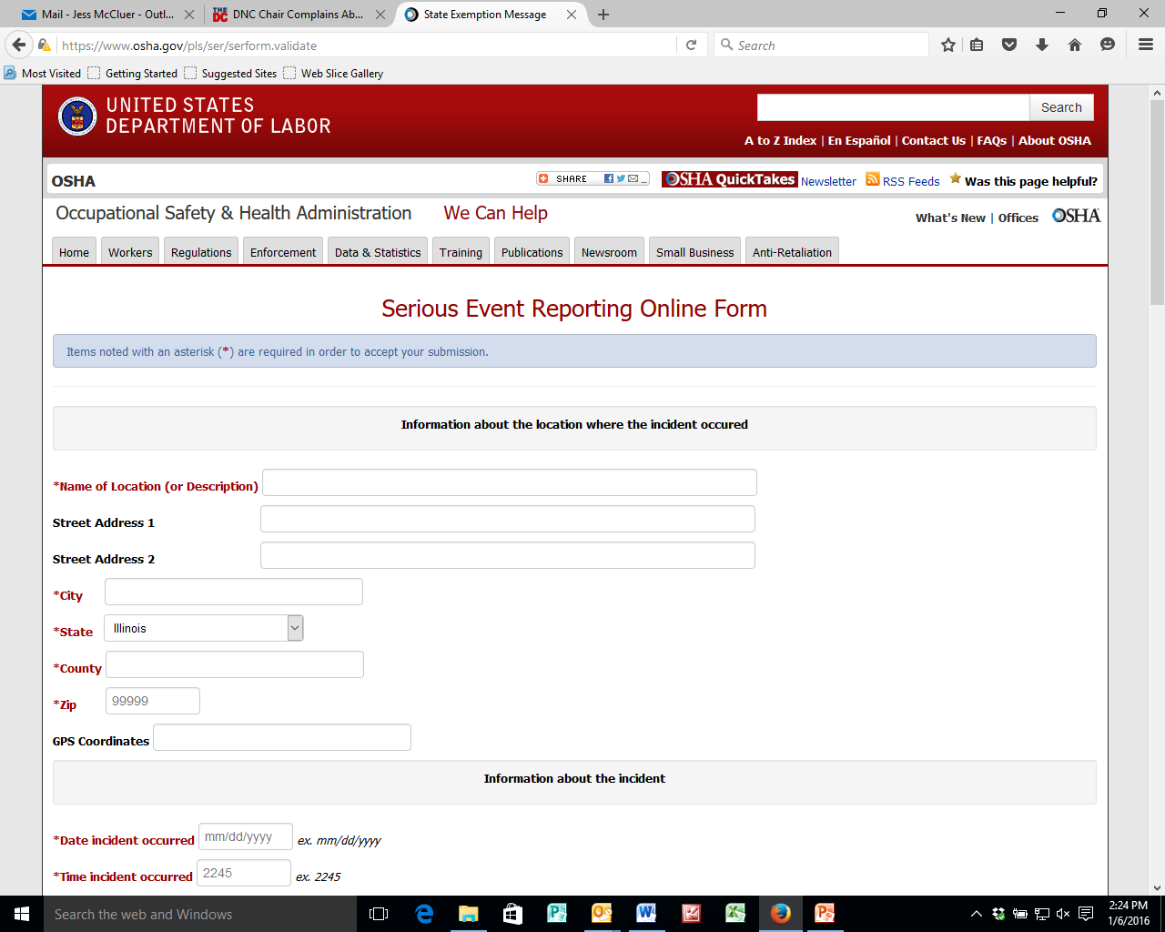

Slide 44
Impact of New Reporting Requirements
Sharp increase in reports to OSHA
More reports = More Inspections/Citations
Expand OSHA’s public shaming campaign

Slide 45
Combustible Dust

Slide 46
Combustible Dust Standard
OSHA will promulgate a Combustible Dust Standard in “several years” – WSJ, April 10, 2014
OSHA changed combustible dust from the pre-rule stage to a long term action in late 2011 - then added it back in 12/21/2012 Regulatory Agenda (Pre rule stage – SBREFA review now in Aug. 2016). Possible reasons:
Final version of NFPA 652
United Nations Globally Harmonized Standard sub-committee efforts to define combustible dust
Combustible dust remains the most common and expensive 5(a)(1) citation

Slide 47
OSHA’s Acknowledges Complexity of Combustible Dust Rule
Wide variety of materials, processes and equipment
Difficulty in truly defining combustible dust
Retrofitting facilities
Additional performance based consensus standards e.g. NFPA
Notes:
In 2008 legislation passed the House. Introduced after the Port Wentworth/Imperial Sugar Incident. OSHA must develop a combustible standard within 18 months. Referenced NFPA standards. NFPA 61 and 654.

Slide 48
Combustible Dust Standards
Combustible Dust issue is similar to the “whack a mole” game…the issue just keeps popping up in other places.
OSHA is using multiple avenues to address the hazard:
Advanced Notice of Proposed Rulemaking
Housekeeping Section of Proposed Walking and Working Surface proposed rule
“Hazard, Other than Chemical” Category in Globally Harmonized Standard for Labeling Amendment to Hazard Communication Standard
NFPA’s New Standard Covering the Fundamentals of Combustible Dust
UN GHS Sub-committee
EPA Risk Management Program

Slide 49
EPA Risk Management Program
EPA is contemplating major revisions to its Risk Management Program (RMP), such as expanding the number of sources under the program. Revisions are based on 2013 incident in West, Texas
RMP was created in 1990 to address catastrophic chemical/gas emissions similar to Bhopal, India in 1984
EPA is now asking if there is any reason why combustible dusts, such as agricultural dusts (e.g., grain dust, pesticide dust, etc.), should not be added to the list of covered chemicals.

Slide 50
Food Safety and Modernization Act (FSMA)

Slide 51
Food Safety Modernization Act of 2011
Signed into law on Jan. 4, 2011
Greatly expands FDA’s authority to regulate the U.S. food supply
Mandates that FDA create a new prevention-based regulatory system to ensure the safety of food/feed products
Requires FDA to develop and issue more than 50 regulations and/or guidance documents

Slide 52
FSMA – Some Key Requirements
Facility Registration is required with FDA every two years during last calendar quarter of even numbered years
FDA granted expanded authority to administratively detain food/feed products
FDA granted authority to issue mandatory recall notices to facilities
FDA granted expanded authority to access food- records

Slide 53
Inspections – Inspections – Inspections
FSMA mandated that FDA inspect all food/grain/feed facilities
Initial inspections within 5 years (high-risk), 7 years (low-risk)
Subsequent inspections every 3 years (high-risk) to 5 years (low-risk)

Slide 54
FSMA Court-Established Deadlines
Subject of Rule | Date for Issuing Final Rule
Current Good Manufacturing Practice (CGMPs) and Preventive Controls – Human Food and Animal Feed | Aug. 30, 2015 (Sept. 17, 2015)
Foreign Supplier Verification Programs | Oct. 31, 2015 (Nov. 27, 2015)
Sanitary Transportation of Food/Feed | March 31, 2016

Slide 55
Impact of FSMA Rulemakings
Human Food and Animal Food CGMPs and Preventive Controls
Facilities “solely engaged” in storing grain and oilseeds are exempt
Foreign Supplier Verification Programs
Applies to importers of grains and oils - could include a grain elevator
Sanitary Transportation of Food
Will apply to grain elevators

Slide 56
Thank You
National Grain and Feed Association
1250 I Street, N.W.
Suite 1003
Washington, DC 20005
Jess McCluer
202-289-0873 | jmccluer@ngfa.org

